Slide 1
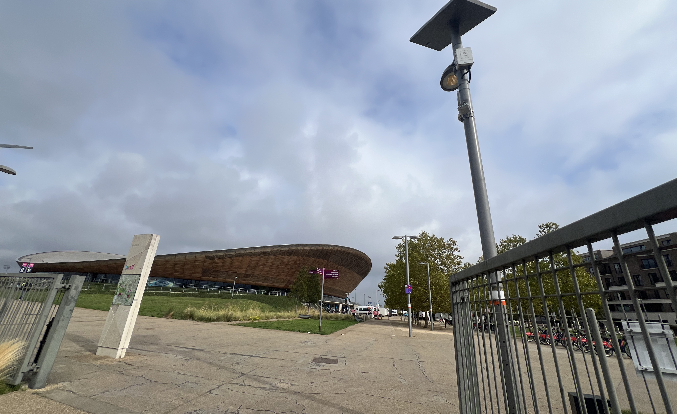
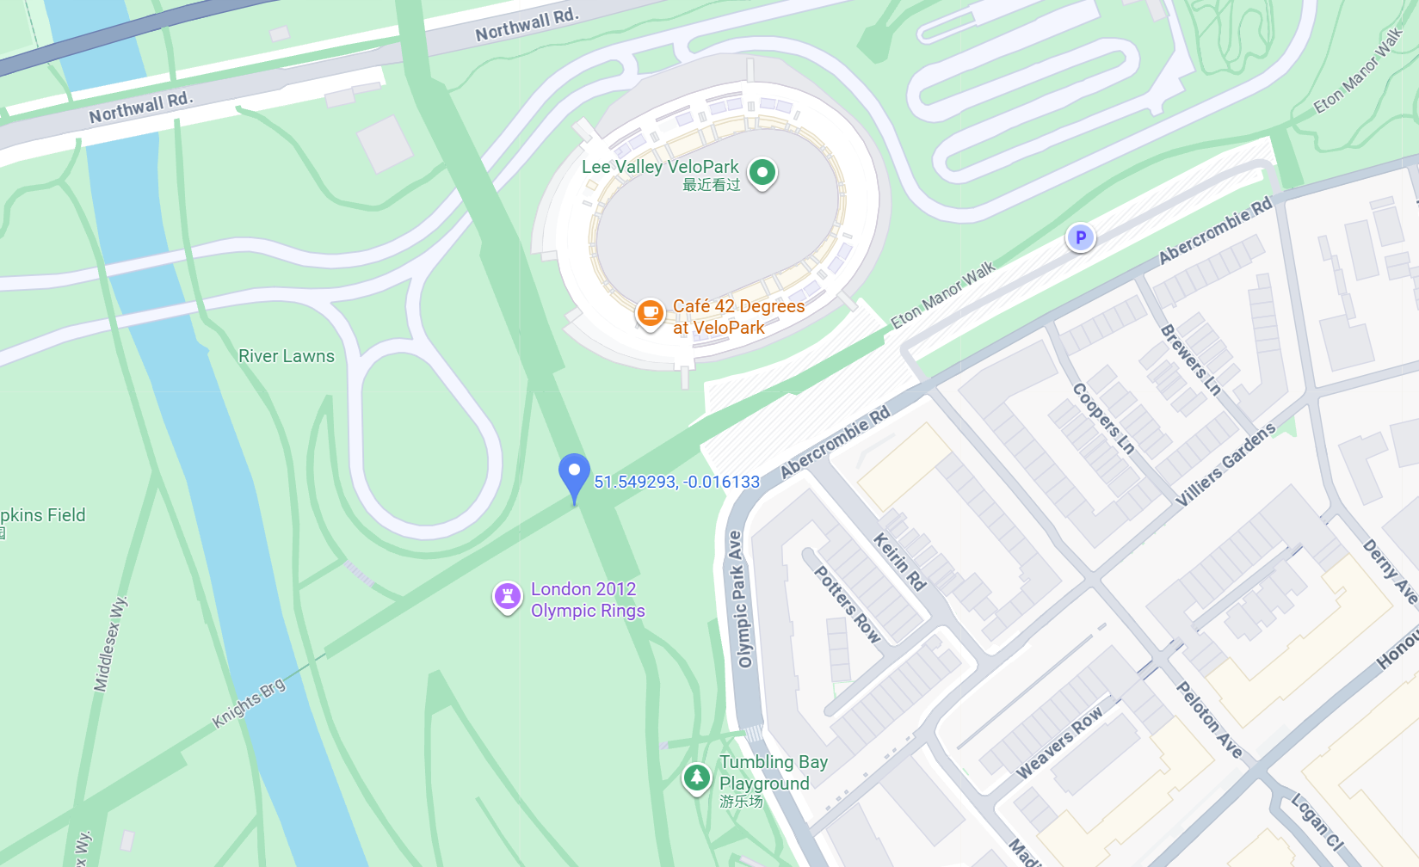
Surveillance Camera and
Environmental Monitoring.
Solar Panel (top) – provides renewable power to the whole sensor node, reducing the need for wired electricity.
LED Lamp (right side) – a high-efficiency streetlight, usually dimmable and possibly controlled remotely.
Dome Camera (bottom right) – a pan-tilt-zoom (PTZ) surveillance camera used for security and crowd monitoring.
Rectangular Box Sensors (middle and bottom left) – these are likely environmental or communication modules
Questions when visiting site?
What was the air quality like when you visited?
How was the sunlight that day?
How many people are there that day?
Location info:
@51.549301, -0.016114
Queen Elizabeth Olympic Park, Abercrombie Rd, London E20 3AB
https://maps.app.goo.gl/NccuP4hSrwMxKGhQ6
what3words: ///gladiators.senior.ropes
Submitted: Junrong Wang Oct 2025
Notes:
A title and a couple of sentences describing the technology and possibly linking to further information online.
A photo of the technology in situ with a corresponding map showing where it is.
2 or 3 questions that you might ask when you are in situ at the site of the technology to engage others in a discussion about that technology
The following geographic data:
Lat Long
Street Address
Google maps link
What3words location
Also add in the names of those submitting this data.

